Slide 1
Final Projects
Lesson 21.2

Slide 2
Today’s Class
Overview of remainder of class
Final project details
Q&A – project, class or software in general
In-class time for starting the project

Slide 3

We are almost there...
Notes:
shutterstock_304864298

Slide 4
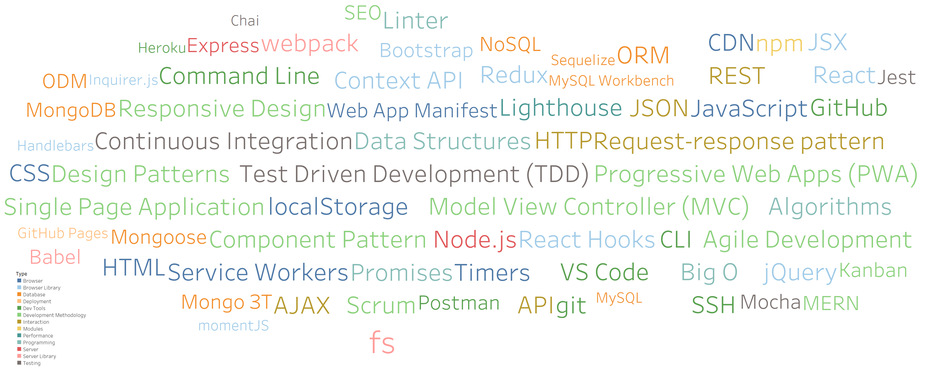
Look at all you have learned!
https://public.tableau.com/profile/spencer.shadley#!/vizhome/UWTechnologies/TechnologiesbyType

Slide 5
Your Goals Re-examined
And why do you want a new career?
To pursue a dream
To escape a dead-end job
To be able to create
To follow a fascination
To attain financial stability
To obtain financial freedom
To challenge yourself
To be a role model

Slide 6
What’s Left
Final Projects
Remaining Topics: (extended) Computer Science
Lightning Talks
Job Workshops
Demo Day!
Notes:
No more new homeworks

Slide 7
Never Stop Learning!
The key to hireability and relevance is to constantly be learning.
The field is always changing and there is never a point where you can call it quits.
Stick with it! It’s a craft that you continue to hone with time.
Notes:
The biggest thing you learned is how to learn
Languages, tools and libraries will all be replaced. The ideas behind them stay and so does your ability to learn.

Slide 8
Final Projects

Slide 9
Your Challenge

Slide 10


Your Challenge
You have plenty of time to work on this.
You have ALL the skills you need.
You have a team of skilled developers.
You have experts willing to help.
No excuses. Time to prove yourself.

Slide 11
Expectations

Slide 12
Expectations
We expect whatever you build to have utility.
We expect you to have market or real-world research that evidences your idea has REAL value to people.
We expect you to have done research on other web/mobile applications in your domain.
We expect you to put serious time and thought into this.
We expect you to report problems you are facing along the way.
We expect you to utilize some form of project management system.
We expect you to use agile development.
We expect you to dig deep into documentation and external resources to learn what you need.

Slide 13
Requirements

Slide 14
Coding Requirements
Uses MERN stack (MySQL is okay)
Deployed
Notes:
There were about 10 requirements, I simplified this to two programming requirements
One extra req – you must have a README

Slide 15
Strongly Recommended
Agile Development
Linter (such as ESLint)
Unit Tests
Continuous Integration (CI) (like Travis)
Model View Controller (MVC)
RESTful architecture
UML Diagrams
Code coverage tools used (like coveralls)

Slide 16
Deliverables

Slide 17
Deliverables
Instead of homework, you will make the MVP for your project. MVP must be completed by May 3rd
Plan, Design, and Research
Ready MVP (Working App!)
Plan for stretch goals (UI polish, bug fixes, extra features, etc.)
Mini-Presentation
Notes:
This should be something you would could turn-in
By the end of class you should have this planned out

Slide 18
Deliverables 1: Plan, Design, and Research

Slide 19
Deliverables 1: Plan, Design, and Research
In this plan, you will include:
An overview of the intended application and WHY you feel it’s valuable.
A set of DETAILED screen-by-screen design layouts with annotations describing all UI/UX components and all data relevant to the screen.
A breakdown of roles by group member.
A schedule for completion of various tasks.
A screenshot of your Project Management Board that shows breakdown of tasks, assigned to group members with a schedule.

Slide 20
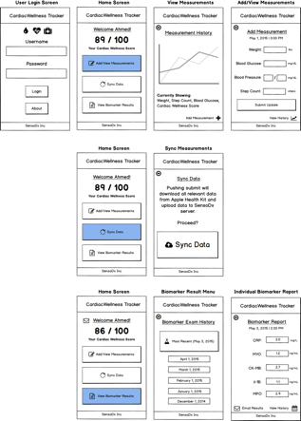
Example UI/UX Flow
Screen Map
This is intended to show you the order in which users would see screens. The three branches correlate with the three button options from the main menu.
Free wireframing tools

Slide 21
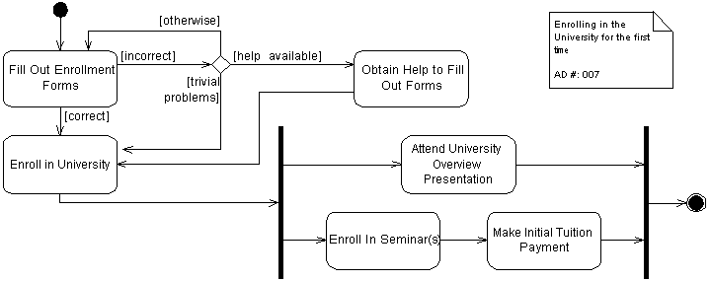
Example UML – Activity Diagram
Enrolling in a University
User Login
(Username, Password)
Add Weekly Measurement (Self-Reporting)
Sync Weekly Measurement (Sensors)
View Biomarker Results
User Health Data
Weight
Blood Pressure
Blood Glucose
Steps Walked
Deliver to Cloud

Slide 22
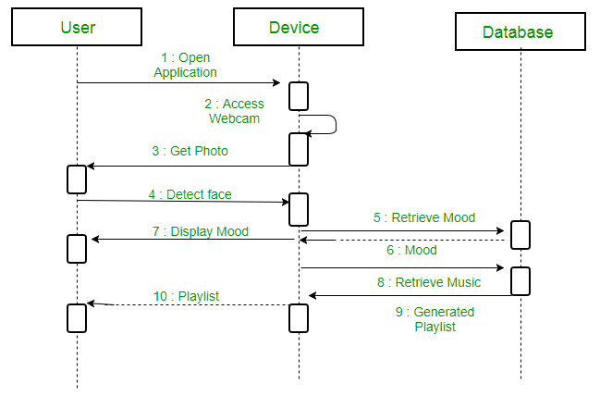
Example UML Sequence Diagram

Slide 23
Project Questions?

Slide 24
Overall Class Questions?

Slide 25
Software Industry Questions?

Slide 26
Final Project Time! Get with your group and work on your project for the rest of class

Slide 27
Look at all you have learned!
https://public.tableau.com/profile/spencer.shadley#!/vizhome/UWTechnologies/TechnologiesbyType

